Slide 1

Investment analysis in the U.S. cab industry
Exploratory data analysis and strategic recommendations
Ruslan Kurmashev - LISUM46

Slide 2
Problem statement & objective
Problem Statement XYZ Private Equity is evaluating potential investment opportunities in the U.S. cab industry. Two major players - Yellow Cab and Pink Cab - are under consideration.
Objective To determine which company presents a stronger case for investment by analyzing profitability, customer behavior, operational coverage, and growth trends using real-world ride and customer data.

Slide 3
Dataset Overview
The dataset consists of over 350,000 cab rides from January 2016 to December 2018, collected across multiple U.S. cities. It integrates information from four data sources:
Cab rides (date, city, company, distance, fare, cost)
Customer profiles (age, income, gender)
Transaction history (linking customers to trips)
City-level information (population, user base)
Additional features such as profit, ride distance classification, income group, and age segments were derived to support the analysis.

Slide 4
Analytical Hypotheses
The following hypotheses were formulated and tested to evaluate cab company performance from multiple perspectives:
H1. Does Yellow Cab generate more profit than Pink Cab?
H2. Is there seasonal variation in ride demand?
H3. Is Yellow Cab more profitable per kilometer across all trip categories?
H4. Which company retains customers more effectively?
H5. Do higher-income customers generate more profit?
H6. Is ride demand higher on weekends than weekdays?
H7. Which company has better coverage across cities?
H8. Is there a difference in profitability by trip distance?
H9. Are there low-profit or loss-making zones hidden in the trip data?

Slide 5
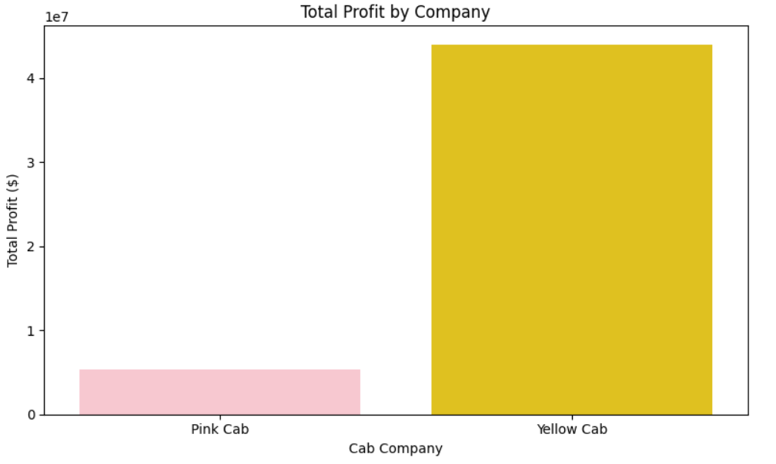

Overall Profitability by Company
Yellow Cab shows significantly higher total and average profit than Pink Cab.
Across the entire dataset, Yellow Cab generated nearly 8 times more total profit and served over 3 times more rides. Its average profit per ride is approximately $160, compared to $63 for Pink Cab.
These results support Hypothesis H1, confirming that Yellow Cab is the more profitable company.

Slide 6
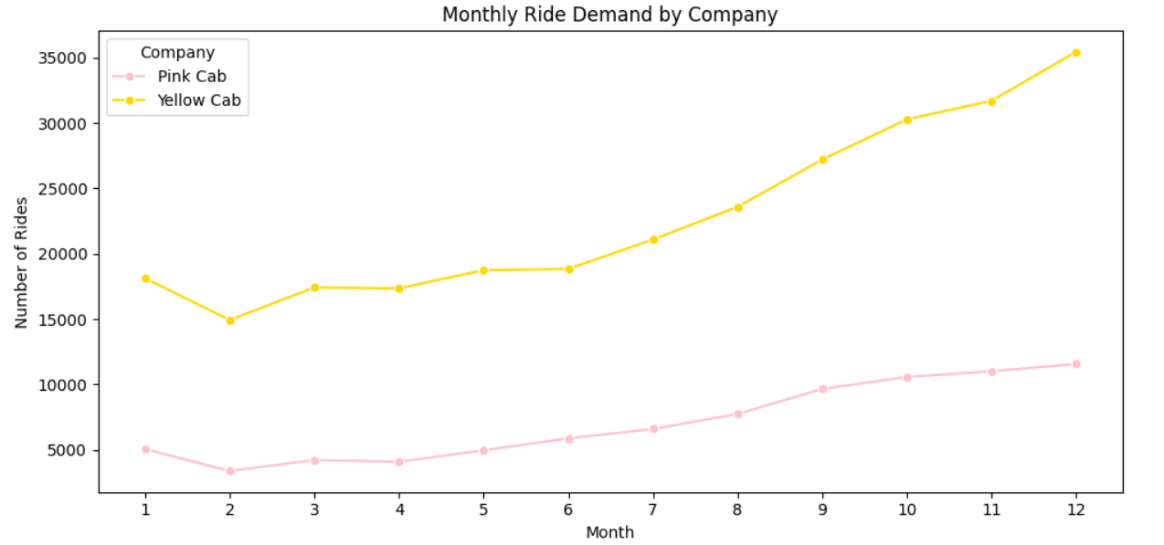
Monthly Ride Demand
Yellow Cab shows a clear upward trend in ride volume throughout the year. Ride demand steadily increases from January to December, indicating possible seasonality effects.
Pink Cab follows a similar pattern but at a much lower scale.
This suggests that Yellow Cab is more responsive to seasonal demand increases, making it a stronger performer over time.

Slide 7
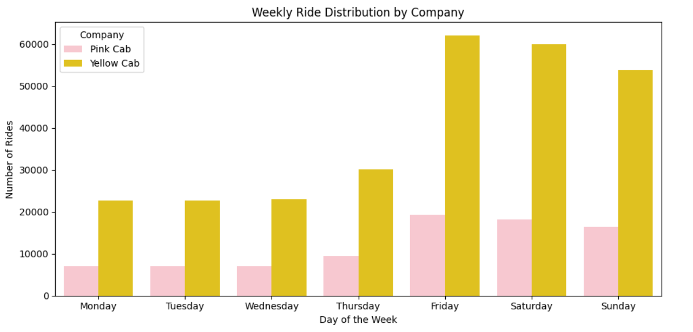
Weekly Ride Demand
Demand for both companies is highest on weekends, particularly Friday to Sunday. However, Yellow Cab consistently outperforms Pink Cab on every single day of the week.
This indicates stronger and more stable customer demand throughout the week.
There is clear evidence of seasonal and weekly variation in ride demand, with Yellow Cab showing significantly stronger performance.
Hypothesis H2 is confirmed: Demand is indeed higher on weekends, and Yellow Cab captures this trend more effectively than Pink Cab.

Slide 8
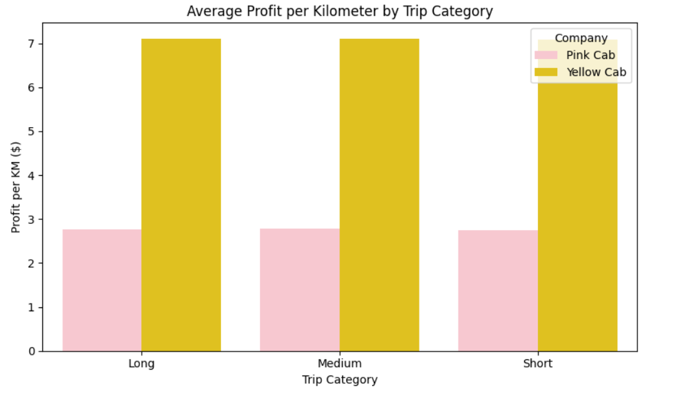
Profit per Kilometer by Trip Category
Yellow Cab shows significantly higher profit per kilometer across all trip categories - short, medium, and long.
In each category, Yellow Cab earns over twice as much per kilometer as Pink Cab. This suggests more efficient pricing and cost control, regardless of trip length.
This supports Hypothesis H3, confirming that Yellow Cab maintains stronger unit profitability across trip types.

Slide 9
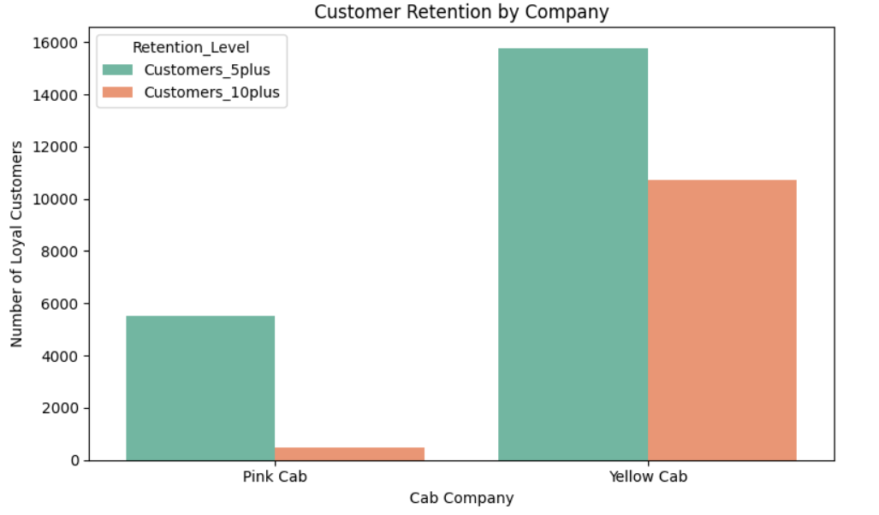

Customer Retention Comparison
• 15,780 customers have taken at least 5 rides with Yellow Cab, compared to 5,515 for Pink Cab. • 10,715 customers used Yellow Cab 10 or more times, while Pink Cab retained only 492 such users.
These results confirm Hypothesis H4 -Yellow Cab has a much stronger ability to retain repeat customers, indicating higher customer satisfaction and long-term engagement.

Slide 10
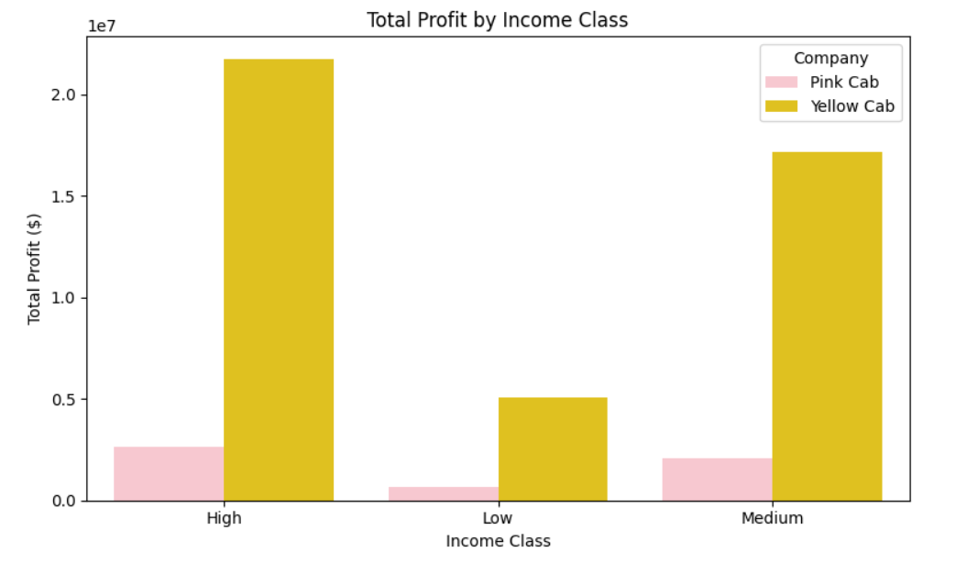
Total Profit by Income Class
Yellow Cab earns much more total profit from every income group, especially from high-income customers. In the high-income segment alone, Yellow Cab generates over $22 million - far exceeding Pink Cab.

Slide 11
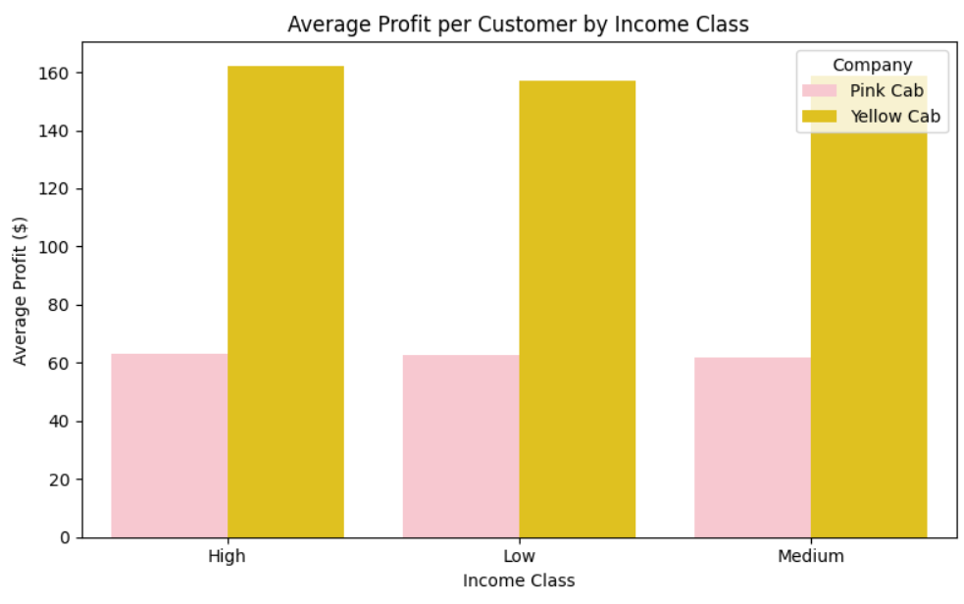
Average Profit per Customer by Income Class
On average, Yellow Cab earns over $160 per customer across all income groups. Pink Cab earns less than $65 per customer in each group. This shows that Yellow Cab provides more profitable service - regardless of income level.
Hypothesis H5 is confirmed: Higher-income users generate more profit, and Yellow Cab captures that value more effectively.

Slide 12
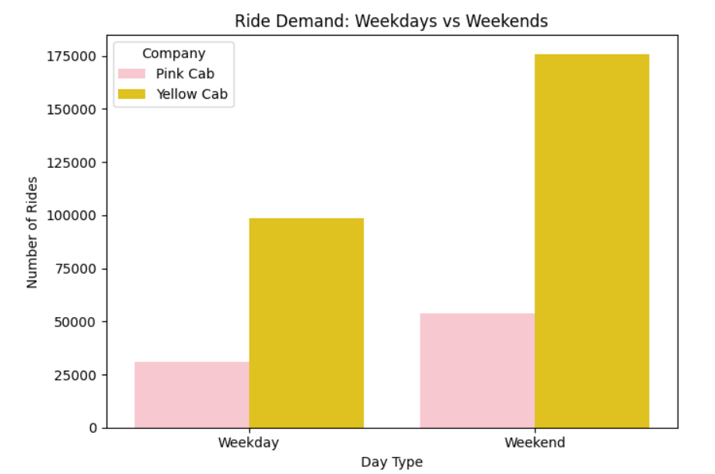
Ride Demand: Weekdays vs Weekends
Ride demand is significantly higher on weekends for both companies. Yellow Cab shows especially strong performance, with over 175,000 rides on weekends alone.
This suggests that Yellow Cab is better positioned to serve peak-time and leisure travel demand.
This supports Hypothesis H6, confirming higher ride volume on weekends and Yellow Cab’s advantage during these periods.

Slide 13
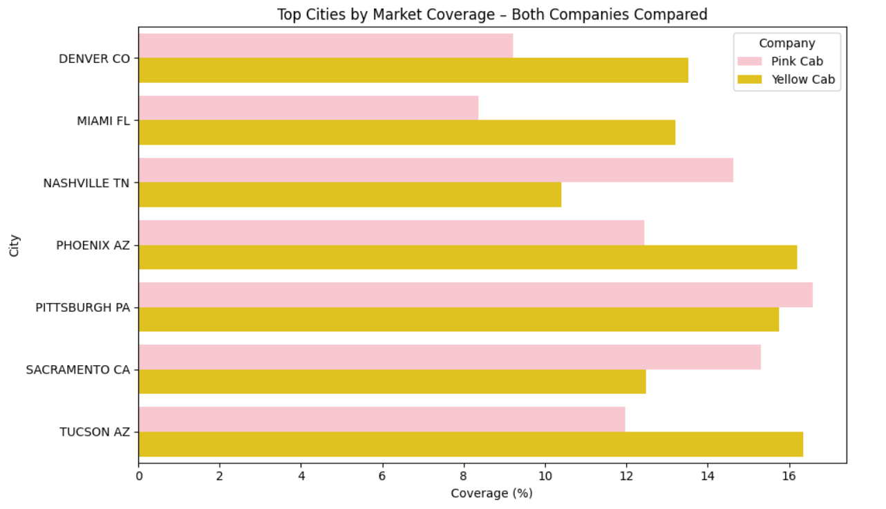
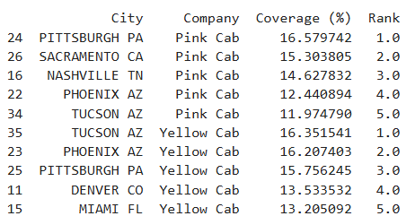
City-Level Market Coverage
Both companies have strong presence in top cities, but Yellow Cab shows slightly broader reach overall.
In cities like Tucson and Phoenix, both cabs perform similarly. However, Yellow Cab ranks in the top 5 in more cities and shows consistent performance across regions.
This partially confirms Hypothesis H7: Yellow Cab has wider and more balanced city-level coverage.

Slide 14
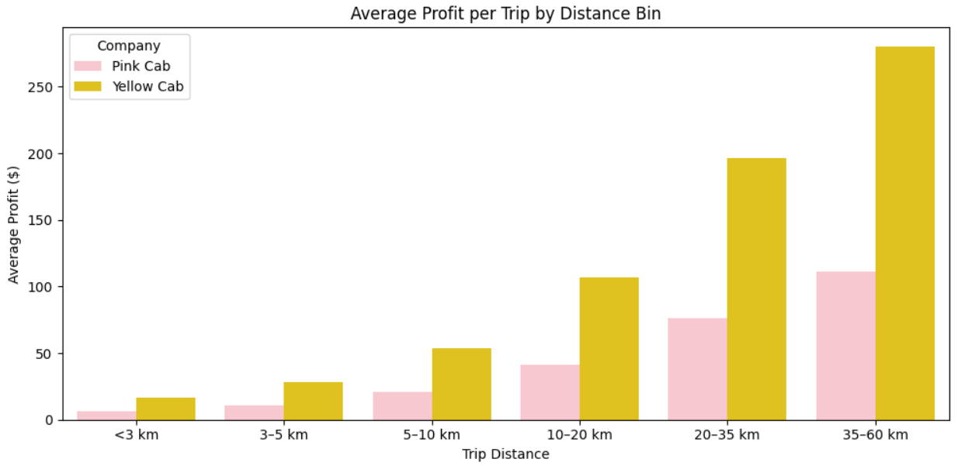
Profitability by Trip Distance
Profit per trip increases as distance grows — for both companies. Yellow Cab shows a much higher profit at every distance, especially for long rides (35–60 km). This indicates strong revenue potential on longer routes.

Slide 15
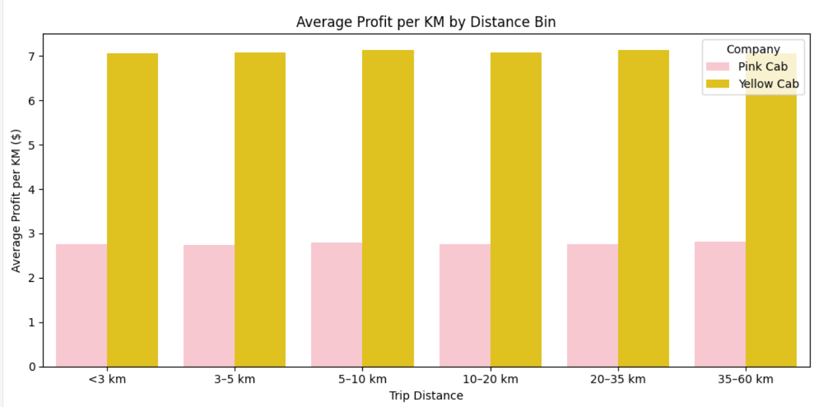
Average Profit per KM by Distance
Yellow Cab maintains a consistent profit per kilometer across all distances. Pink Cab's profit per KM is steady but much lower — about 2.5x less than Yellow Cab. Yellow Cab is more efficient regardless of how far the customer travels.
Hypothesis H8 Yellow Cab is more profitable at all distances — both in total and per kilometer — showing better operational performance across trip types.

Slide 16
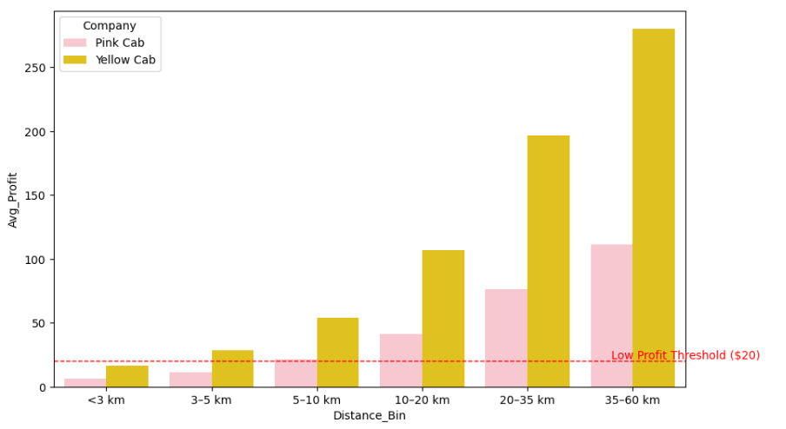
Low-Profit Zones by Trip Distance
Trips under 5 km are low-margin for both companies, falling below the $20 profit threshold. Pink Cab remains close to the low-profit zone up to 10 km, while Yellow Cab becomes profitable earlier.
Hypothesis H9 is confirmed: Short-distance rides are low-profit segments, especially for Pink Cab.

Slide 17
Final Recommendation
Final Recommendation: Invest in Yellow Cab
After analyzing over 359,000 cab rides across 20 U.S. cities, Yellow Cab clearly outperforms Pink Cab in all key business metrics:
Profitability: $43M vs. $5M total profit - an 8× advantage
Ride Demand: consistently higher volume across all months and weekends
Per-Kilometer Profit: $7.1/km vs. $2.7/km across all trip lengths
Customer Retention: 3× more repeat riders (5+ rides), 20× more loyal users (10+ rides)
Income Segments: stronger performance across all income classes
City Coverage: broader and more consistent presence in key markets
Conclusion: Yellow Cab demonstrates superior financial returns, loyal customer base, and scalable operations. We strongly recommend investing in Yellow Cab for sustainable long-term growth.

